Slide 1
Combined analysis of single cell transcriptome and bulk RNA-seq
Practices

Slide 2
1. Study design
Purpose: Integrating single cell data and bulk RNA-seq to study the microenvironmental alterations between metastatic and non-metastatic esophageal cancer lymph nodes
Datasets:
scRNA-seq
Reference: https://www.nature.com/articles/s41467-021-27599-5
SRA raw data: https://www.ncbi.nlm.nih.gov/sra/?term=PRJNA777911
bulk RNA-seq
TCGA ESCC expression profile data
Methods:
Download SRA data and convert to fastq format
Compute the expression matrix using the cellranger count method
Integrating the data of lymph node metastatic and non-metastatic samples
Basic analysis of scRNA-seq data
Combined analysis with bulk RNA-seq
Notes:
Papalexi E and Satija R. Single-cell RNA sequencing to explore immune cell heterogeneity, Nature Reviews Immunology 2018 (https://doi.org/10.1038/ nri.2017.76)

Slide 3
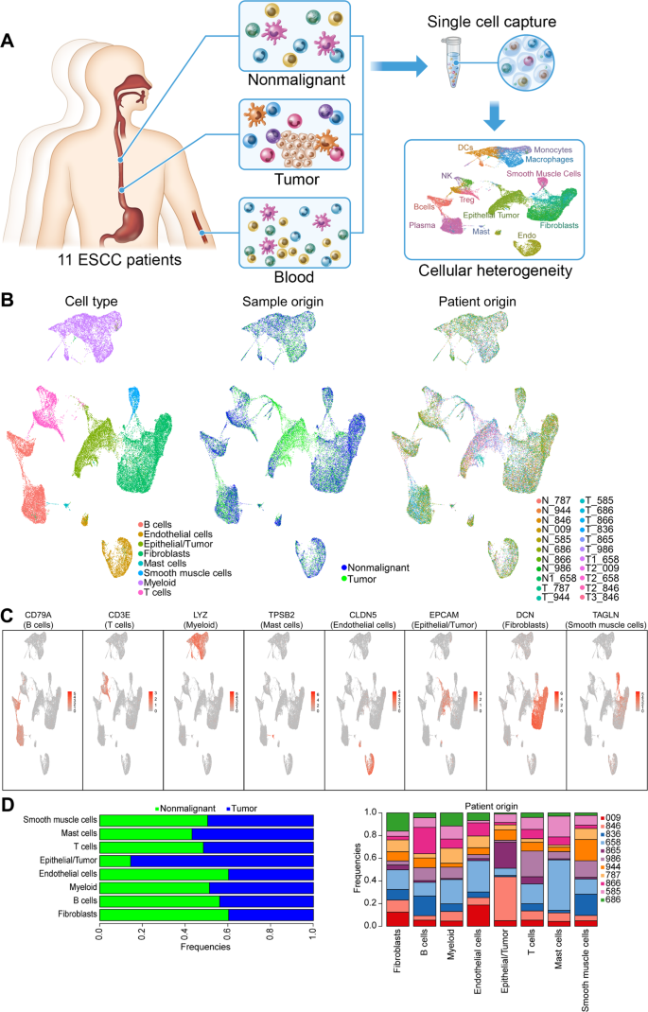
2. Introduction of scRNA-seq data
Samples from 11 ESCC patients were included in this study, and the types included peripheral blood mononuclear cells, tumor tissue and non-tumor tissue.
The authors compared the cell compositions between tumor-derived and non-tumor-derived tissues, identified prominent diversity among fibroblast compartments, and subpopulations of CST1+ myofibroblasts with potential biological significance and prominent prognostic value. These results unveiled the biology of esophageal cancer and provide an important theoretical basis for advancing therapeutic interventions in this malignancy.
Image source https://www.nature.com/articles/s41467-021-27599-5

Slide 4
3. Methods details of this study
Step 1: Download SRA data and convert to fastq format
wget https://sra-pub-run-odp.s3.amazonaws.com/sra/SRR16796883/SRR16796883
wget https://sra-pub-run-odp.s3.amazonaws.com/sra/SRR16796863/SRR16796863
Note: After converting data to fastq format, the fastq file name should be modified in line, in the format
[sample name]_S1_L001_R[1/2]_001.fastq.gz
Step 2: Use cellranger count method to calculate the expression matrix
wget https://cf.10xgenomics.com/supp/cell-exp/refdata-gex-GRCh38-2020-A.tar.gz
Note: This step can also use STAR-solo, however, after the author‘s test, the output of STAR-solo differs greatly from cellranger (the number of genes, the number of UMIs, and the number of cells obtained by STAR-solo are low), so it is recommended to use the official cellranger software provided by 10X.
Step 3: Integrating data of lymph node metastatatic and non-metastatic samples
Merging samples under different conditions, here the integration method of seurat is used
Harmony and liger two methods are also available (participants practice on their own)

Slide 5
Step 4: Basic analysis of scRNA-seq data
Normalization (elimination of library variation)
Dimensionality reduction (identification of the top 2000 genes with maximum variation, expression normalization, PCA)
Clustering
Differential expression analysis
Cell type annotation
Step 5: Combined analysis with bulk RNA-seq
Validation of DEGs on TCGA ESCC dataset
Prognostic correlation analysis

Slide 6
Useful references
https://github.com/alexdobin/STAR/blob/master/docs/STARsolo.md
https://support.10xgenomics.com/single-cell-gene-expression/software/pipelines/latest/using/tutorial_ct

